Slide 1
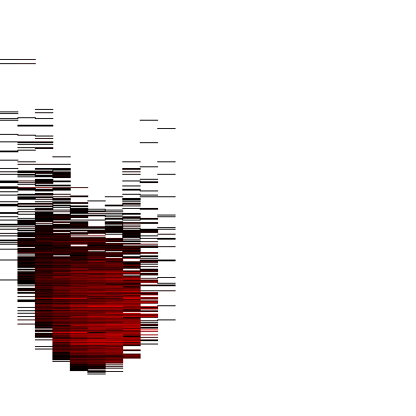
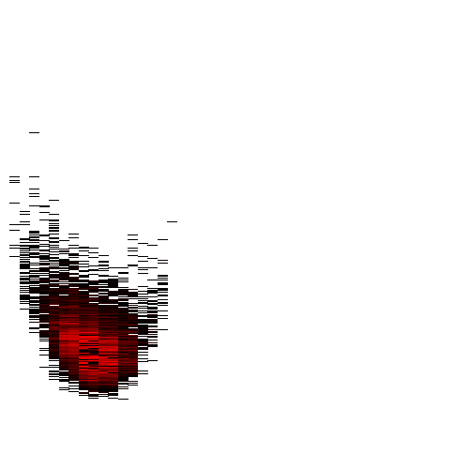




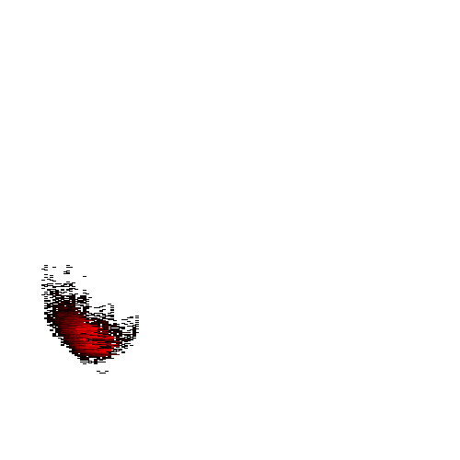

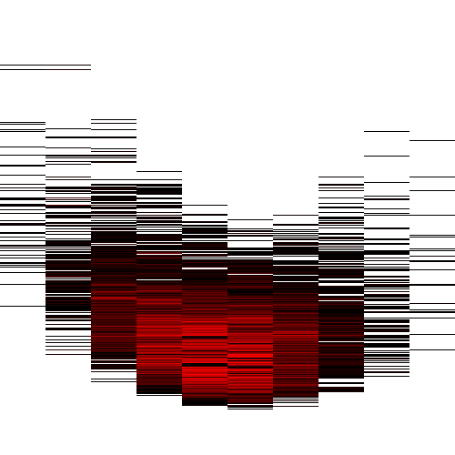
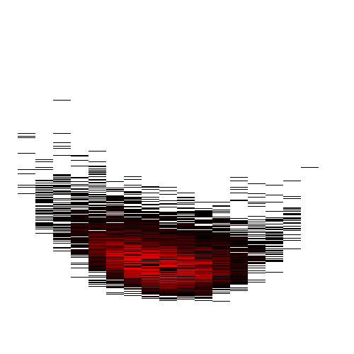
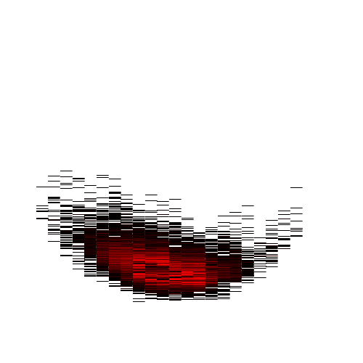


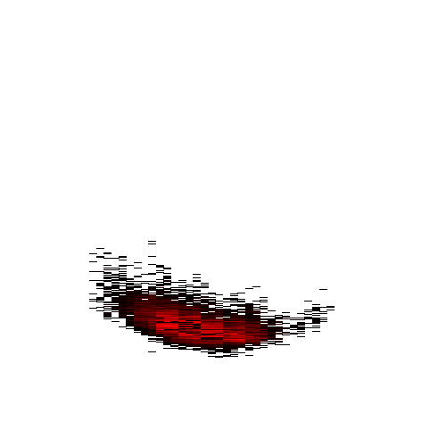


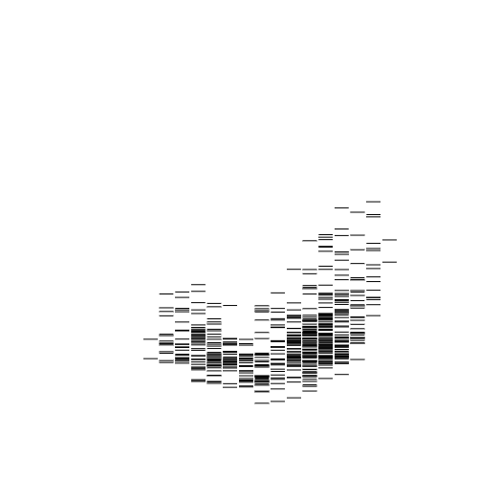
n=10
n=20
n=30
n=40
n=50
n=60
n=70
n=80
(d)
+ background
(c)
Standard
0%
100%
Low information content
High information content
(a)
Information content
Information content
(b)
High information content
Low information content
0%
100%
0%
100%
Frequency
0%
100%
Frequency

Slide 2


The ODS reference system
The ODS reference system. (a) shows the standard reference system discussed so far, where the information content is shown in descending orientation from top to bottom on the vertical axis of each ODS, and the ascending frequency is shown from left to right on the horizontal axis. (b) shows an alternative reference system in which the axis of the information content is inverted for an ascending synchronization with the frequency (both axes leading to 100%). (c) It shows eight variants of standard ODSs for the HIV-1 genome arranged in a line, where the first ODS originates from a small sliding window (n=10 letters) and the last ODS that originates from a long sliding window (n=80 letters). (d) It shows the optional ODSs for the HIV-1 genome arranged in the same order and the same sliding window parameters.
Cite this work as:
Paul A. Gagniuc. Algorithms in Bioinformatics: Theory and Implementation. John Wiley & Sons, Hoboken, NJ, USA, 2021, ISBN: 9781119697961.

